Slide 1

Presented by: Patel Darshil
Roll No: 89
Enrollment No: 22002170110109
GAME STORE

Slide 2
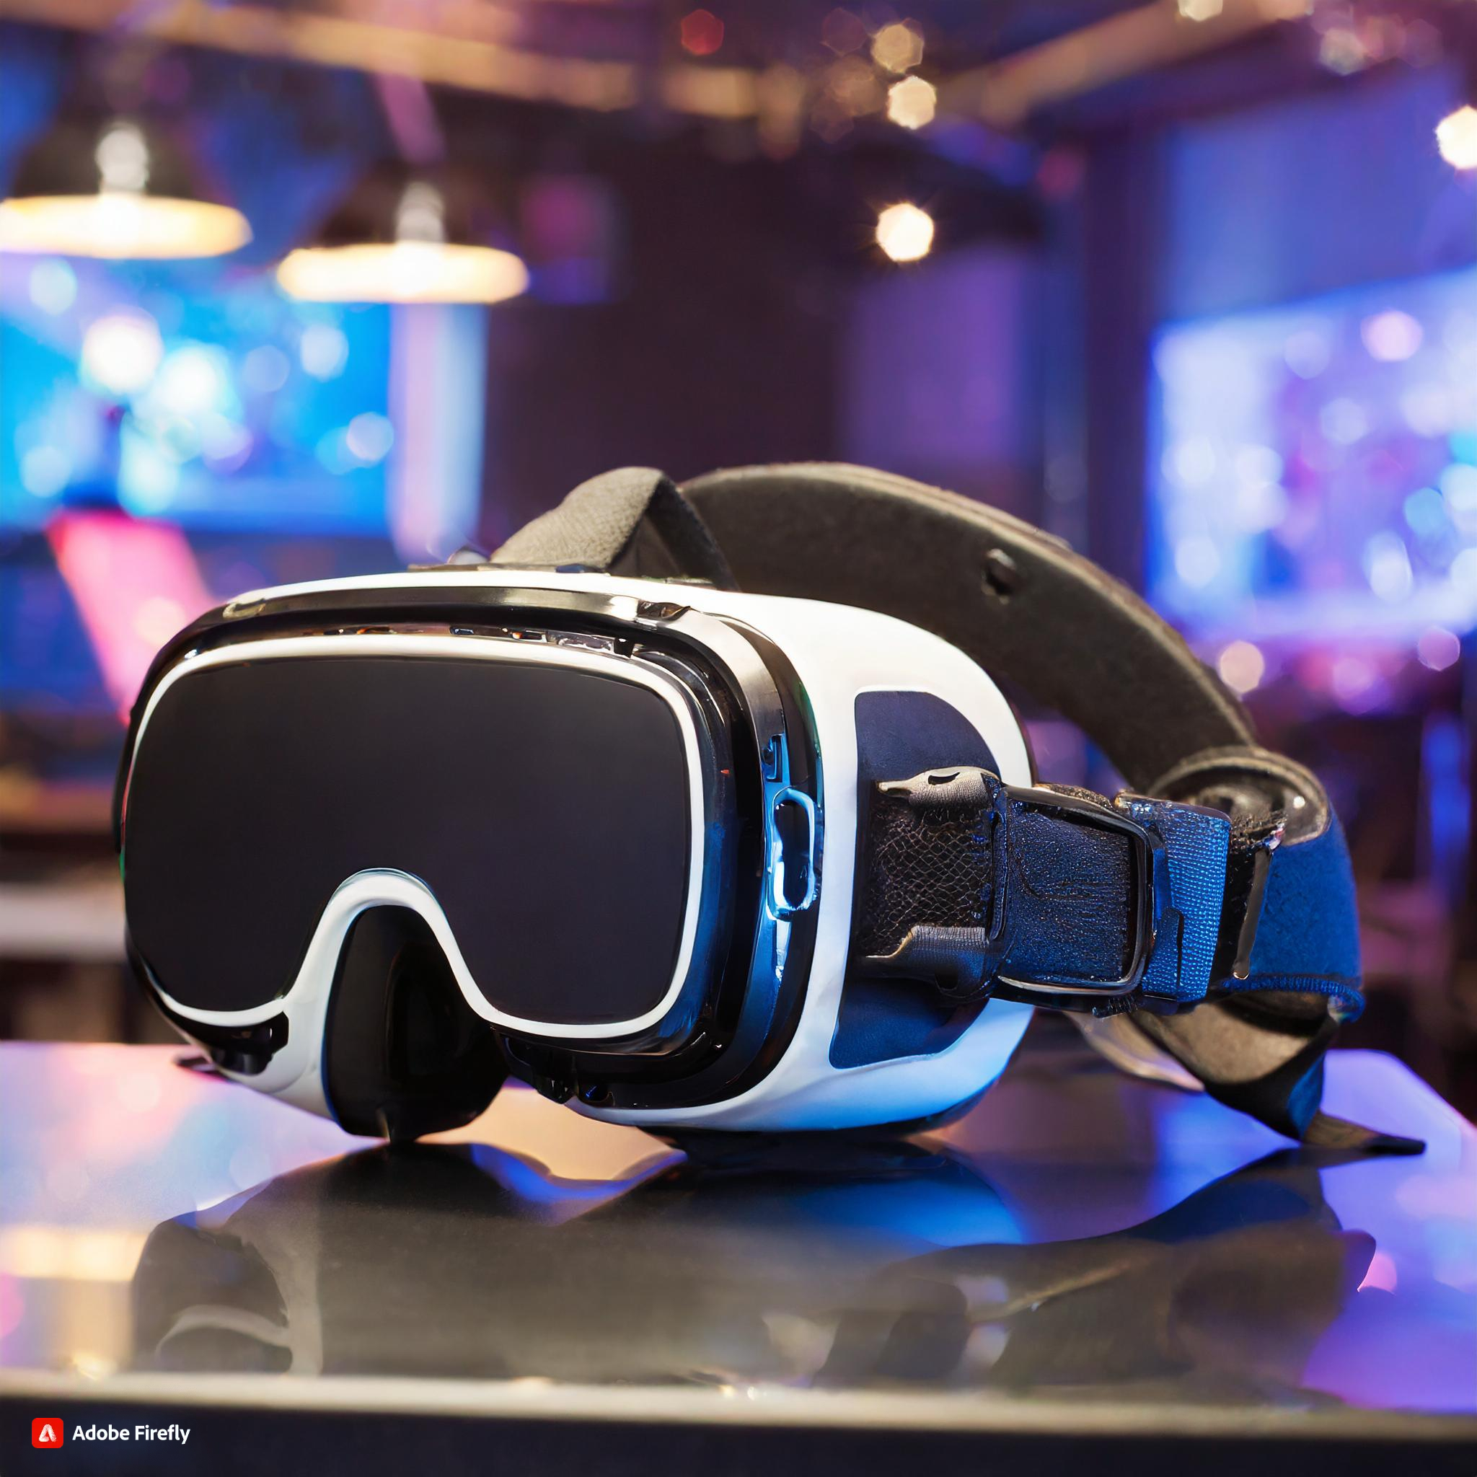
Intro Features Uses Layout Conclusion
Intro Features Uses Layout Conclusion
INTRODUCTION
The gaming industry has experienced consistent growth over the years.
Sales in digital game stores, like Steam , Epic games are really important for both the people who make games and the people who play them.

Slide 3

Intro Features Uses Layout Conclusion
Intro Features Uses Layout Conclusion
FEATURES
Wide Collection of Games.
High-Quality Gaming..
User-Friendly Interface.
Responsive Layout.
Base Game and Add-ons (DLC packs)

Slide 4

Intro Features Uses Layout Conclusion
Intro Features Uses Layout Conclusion
USE-CASES
Wide Selection.
Sales and Discounts.
Pre-Orders and Exclusive Content.
Instant Access.
Updates and Patches.
For Add-on packs.

Slide 5
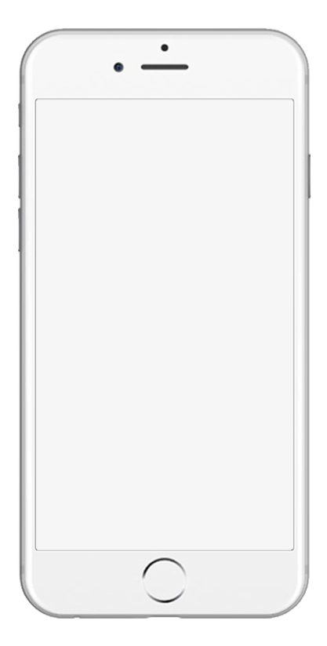

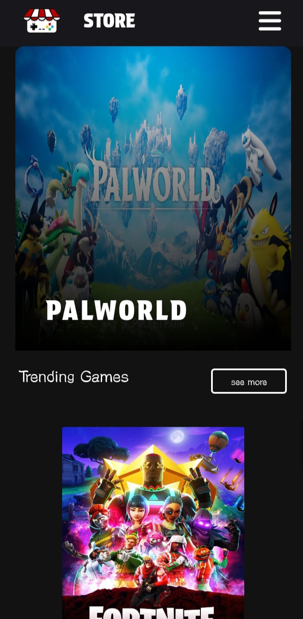
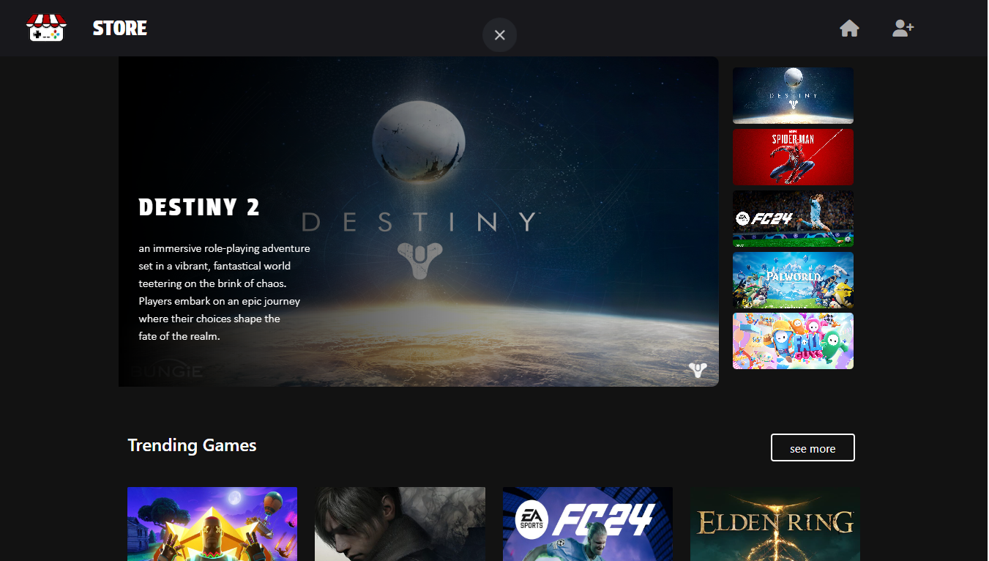
Intro Features Uses Layout Conclusion
Intro Features Uses Layout Conclusion

Slide 6

Intro Features Uses Layout Conclusion
CONCLUSION
There are many technology such as virtual reality , cloud gaming are in development to provide personalized experience.
digital game store websites play a crucial role in the future of gaming.

Slide 7
THANK YOU

